Slide 1



PREDICTING
RETIREMENT AGE
EDGAR ABASOV

Slide 2



INTRODUCTION
Project focused on predicting retirement age using advanced machine learning techniques applied to the Survey of Health, Ageing and Retirement in Europe (SHARE) Wave 6 dataset

Slide 3


PROJECT OBJECTIVES
Develop accurate classification models to predict retirement age based on health, socio-economic, and policy-related factors.
Identify key predictors of retirement age (e.g., health status, income, pension policies).
Provide insights for policymakers on aging and retirement trends.
Research Question: How do bio-medical and socio-economic factors interact to influence retirement age in European populations?

Slide 4
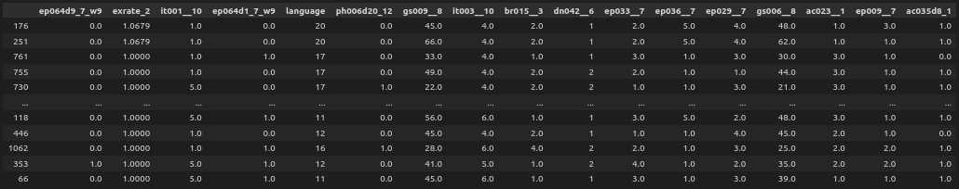
DATASET DESCRIPTION
Source: SHARE Wave 6 (2014-2015), part of a 10-wave longitudinal study.
Key Features:
Demographic: Age, gender, education, marital status.
Health: Physical/mental health, biomarkers
Socio-economic: Income, wealth, employment status, pension details.
Retirement: Self-reported retirement age, labor market exit reasons.
Sample Size: ~68,000 individuals across 18 countries.

Slide 5

METHODOLOGY - DATA PREPROCESSING
Converting from the source format to a more effective format
Selecting variables: with potential usability level
Handled missing values using multiple imputation.
Encoded categorical variables (e.g., one-hot encoding for education).
Normalised continuous variables (e.g., income, health scores).

Slide 6
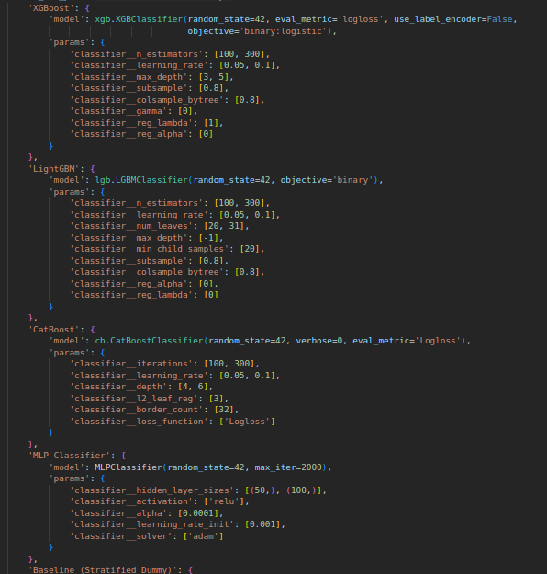
MODEL SELECTION
Classification Algorithms:
Logistic Regression: Baseline for interpretability.
Random Forest: Captures non-linear relationships.
XGBoost: High performance for complex datasets.
Feature Selection:
Experiment: sklearn tree view suggestion
Final: SHAP
Tools: Python (pandas, scikit-learn, XGBoost)

Slide 7
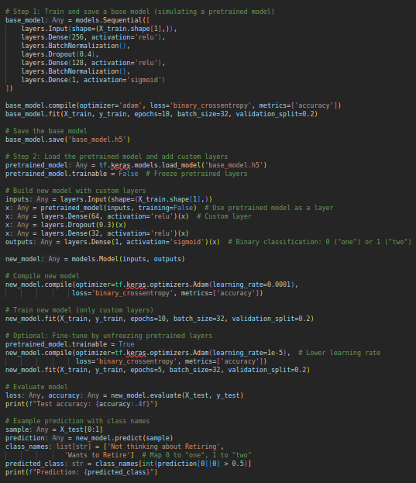
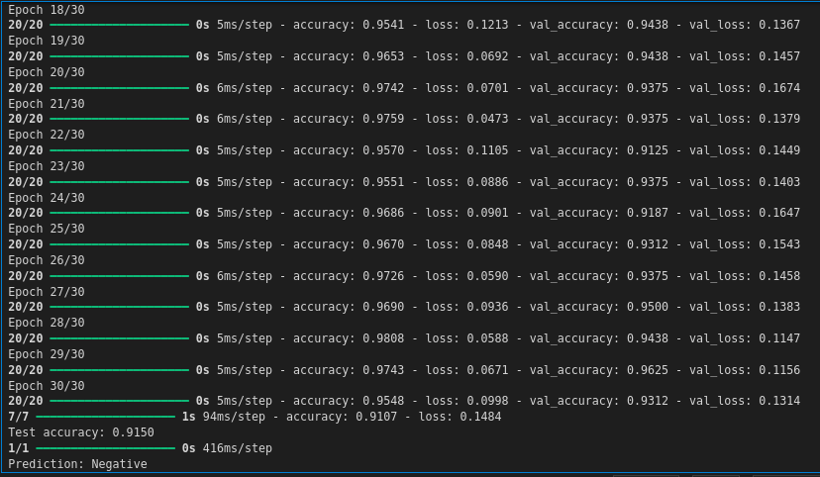
TENSORFLOW CLASSIFICATION

Slide 8
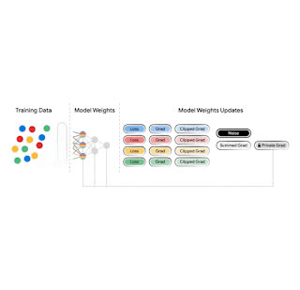
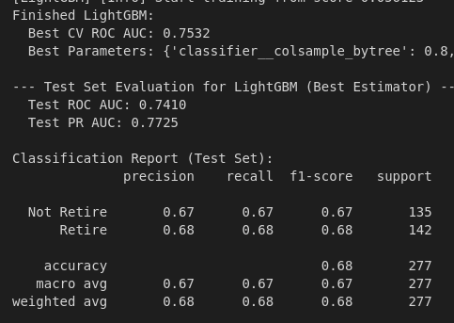
TRAINING AND EVALUATION
Data Split:
80% training, 20% test.
Evaluation Metrics:
Accuracy, precision, recall, F1-score.
AUC-ROC for class discrimination.
Techniques:
3-fold cross-validation for robustness.
GridSearch
Manual handling imbalanced classes of target
Visualization: Confusion matrix and ROC curve (include sample charts), model comparision bars

Slide 9
RESULTS
 | LightGBM | CatBoost | Support Vector Machine | MLP | XGBoost | Deep Neural Network
Precision-Recall | 0.7725 | 0.7634 | 0.6724 | 0.6708 | 0.7607 | 0.9949
ROC AUC | 0.7410 | 0.7338 | 0.6612 | 0.6927 | 0.7423 | 0.9954
Epochs/ Iterations | 100/300 | 100/300 | 100/300 | 2000 | 100/300 | 30

Slide 10
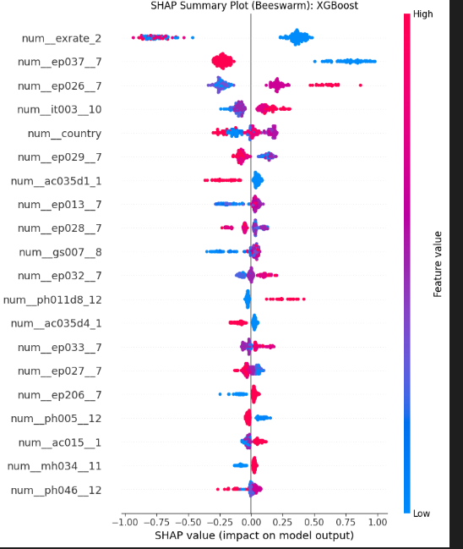
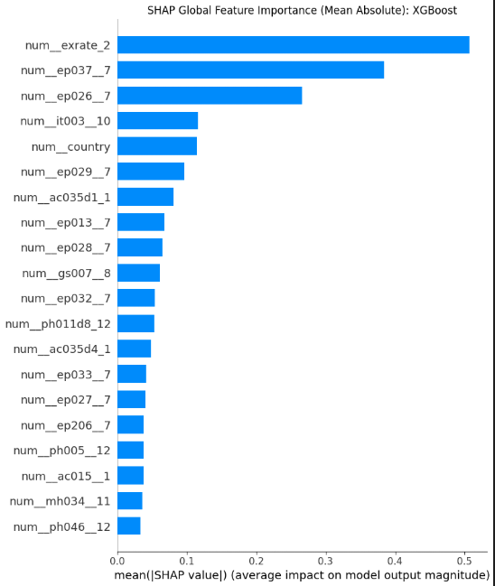

CONCLUSION

Slide 11
THANK YOU
HTTPS://GITHUB.COM/METAPHYSICIST1/PREDICTING-RETIREMENT-AGE

Slide 12
